Slide 1
Chapter Two Process Management

Slide 2
What is Process?
A process is a running piece of code or a program in execution.
The term process, used somewhat interchangeably with 'task' or 'job'.
Modern computers work in a multitasking environment in which they execute multiple programs simultaneously.
Decomposition:-is a process of split up a given big/large problem/process, in to several sub process that can be solved/execute concurrently/parallel.
These sub programs cooperate with each other and share the same resource, such as CPU, memory, files, and I/O devices, to accomplish its task.

Slide 3
Cont…
In order to execute multiple tasks simultaneously, operating system manages all processes to facilitate proper utilization of these resources.
A program by itself is not a process, b/c a program is a passive entity, whereas a process is an active entity.
The execution of a process must progress in a sequential fashion.
i.e. The CPU executes one instruction of the process after another until the process completes.

Slide 4
Cont…
Some of the Os activities related with process management are:-
Process creation and deletion.
Process suspension and resumption.
Provision of process communication and resource sharing.
Deadlock handling

Slide 5
Process States
A process goes through a series of discrete/isolated process states.
New State: The new process being created.
Ready State: The new process waiting to be assigned to the processor.
Running State: A process is said to be running state, if it using the CPU at that particular instant.
Blocked (or waiting) State: A process is said to be blocked, if it is waiting for some event to be happen.
Terminated state: The process has finished execution.

Slide 6
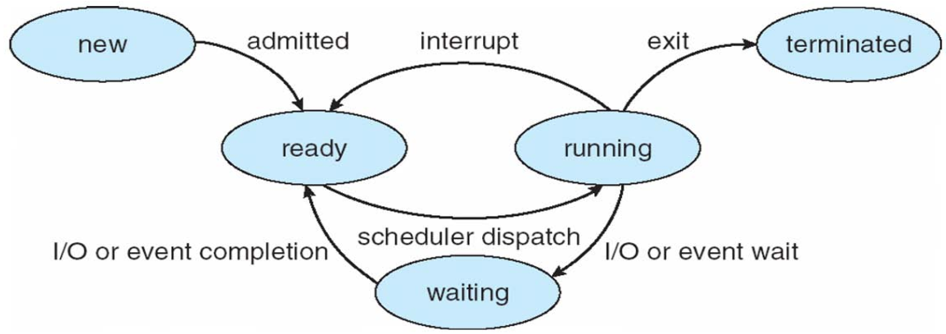
Cont…

Slide 7
Cont…
A process in Os is represented by a data structure known as a Process Control Block (PCB) or process descriptor.
It can keep the track of process information.
For each process, it holds information related to that process, such as: the current state of the process, unique identification of the process and etc.

Slide 8
How can several processes share one CPU?
Os must make sure that processes do not interfere with each other. This means
Fair scheduling -Making sure each process gets a chance to run inside the CPU.
Protection: Making sure they do not modify each other's state.
By context Switching
Most modern computer systems allow more than one process to be executed simultaneously. This is called Multitasking systems.
Context switching means switching the CPU to different processes. It requires saving of the state of the current process into the PCB and load the saved PCB of the previous or new process.

Slide 9
How does CPU switch between different processes?
Dispatcher/Scheduler: means the inner-most portion of the OS that runs processes without interference.
Scheduler supports and facilitates the following activities
Run process
Save its state.
Load state of another process
Run the new process and
Reload the suspended\previous process.

Slide 10
When process scheduling is required?
When more than one process is running, the operating system must decide which one should first run.
The part of the operating system concerned with this decision is called the scheduler, and algorithm it uses is called the scheduling algorithm.
In a multitasking and uniprocessor system scheduling is needed because more than one process is in ready and waiting state. It helps no processes wait for a long time.

Slide 11
What the scheduler try to achieve?
Fairness: A scheduler makes sure that each process gets its fair share of the CPU and no process can suffer indefinite postponement/delay.
Efficiency: Scheduler should keep the system/CPU busy 100% of the time when possible.
Response Time: A scheduler should minimize the response time for interactive user.
Turnaround: A scheduler should minimize the time batch users must wait for an output of executing process. It is cpu time + Wait time.
Throughput: A scheduler should maximize the number of jobs processed per unit time.

Slide 12
Type of scheduling
The Scheduling algorithms can be divided into two categories with respect to how they deal with interrupts.
preemptive Scheduling:-The strategy of allowing processes that are logically running to be temporarily suspended is called Preemptive Scheduling.
Non preemptive Scheduling:-A scheduling discipline is non preemptive if once a process has been given the CPU, the CPU cannot be taken away from that process until the assigned process completes its execution.
Short jobs are made to wait by longer jobs.

Slide 13
Scheduling Algorithms
The following are some scheduling algorithms:
First Come First Served (FCFS) Scheduling.
Shortest Job First (SJF) Scheduling.
Shortest Remaining Time (SRT) Scheduling.
Round Robin Scheduling.
Priority Scheduling.

Slide 14
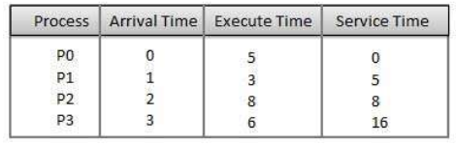
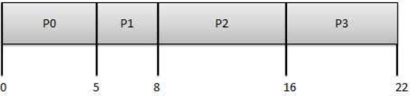
First Come First Served (FCFS) Scheduling
Jobs are executed on first come, first serve basis. i.e. Processes are dispatched according to their arrival time on the ready queue.
Easy to understand and implement.
Poor in performance b/c average wait time is high. Example:
Wait time of each process is following:-

Slide 15
Cont…
Process | AT | ET | ST | WT(ST_AT) | AWT
P0 | 0 | 5 | 0 | 0 | 5.55
P1 | 1 | 3 | 5 | 4
P2 | 2 | 8 | 8 | 6
P3 | 3 | 6 | 16 | 13

Slide 16
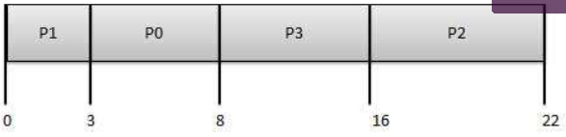
Shortest-Job-First (SJF) Scheduling
Shortest-Job-First (SJF) is a non-preemptive discipline in which waiting job (or process) with the smallest estimated run-time-to-completion is run first.
Since the SJF scheduling algorithm gives the minimum average time for a given set of processes, it is probably optimal.
Example: From the above example the waiting times calculated:-
Process | AT | ET | ST | WT(ST_AT) | AWT
P0 | 0 | 5 | 3 | 3-0=3 | 5.5
P1 | 1 | 3 | 0 | 0-0=0
P2 | 2 | 8 | 8 | 8-2=6
P3 | 3 | 6 | 16 | 16-3=13

Slide 17
Round Robin Scheduling
One of the simplest and most widely used algorithms is round robin (RR).
In the round robin scheduling, processes are dispatched in a FIFO manner, but are given a limited amount of CPU time called a time-slice or a quantum.
If a process does not complete before its CPU-time expires, the CPU is preempted/interrupted and given to the next process waiting in a queue.
The preempted process is then placed at the back of the ready list.
Example:

Slide 18
Priority Scheduling
The basic idea is straightforward: each process is assigned a priority, and priority is allowed to run.
Equal-Priority processes are scheduled in FCFS order or in RR.
Example:

Slide 19
Inter process Communication (IPC)
One of the benefits of multitasking is that several processes can be made to cooperate in order to achieve their ends. To do this, they must do one of the following.
Communicate: Inter-process communication (IPC) involves sending information from one process to another, since the output of one process may be an input for the other process.
Share data: A segment of memory must be available to both processes.
Waiting: Some processes wait for other processes to give a signal before continuing.
The interaction or communication between two or more processes is termed as Inter-process communication (IPC).

Slide 20
Assignment #1
write a briefly short note about network Os, distributed Os, time-sharing Os and batch Os?
Write the difference between the above mentioned Os?
Write the advantage and disadvantage of these Os?
Least at least 3 real world technology's for each Os that works using one of the above mentioned Os?

Slide 21

Thank You!!!

